Slide 1

LOGIC PUZZLE SOLVER SUDOKU
Presented By :
Wahidun Akter 2022188642
Rashedul Islam Tono 2022154642
Nusrat Zahan 2013942642

Slide 2
1
INTRODUCTION
Sudoku is a logic-based number puzzle played on a 9x9 grid, where each row, column, and 3x3 sub-grid must contain digits
1-9 without repetition, promoting reasoning and problem-solving.

Slide 3
2
HOW IT WORKS ?
A Sudoku solver uses backtracking algorithms to fill the grid. It starts by placing a number in an empty cell, then recursively attempts to fill the next cell. If a conflict arises (number repeats in a row, column, or 3x3 sub-grid), it backtracks to the previous cell and tries a different number. This process continues until the grid is correctly filled.

Slide 4
3
CONSTRAINT SATISFACTION PROBLEMS (CSP)
The CSP solver uses these steps:
Assign a value: Start by placing a number in an empty cell.
Check constraints: Ensure this number doesn't break any Sudoku rules.
Propagate constraints: Update the possible numbers for other cells based on this assignment.
Backtrack if needed: If a conflict arises, undo the last step and try a different number.

Slide 5
4
Pseudocode for backtracking
procedure backtrack(P, c) is
if reject(P, c) then return
if accept(P, c) then output(P, c)
s ← first(P, c)
while s ≠ NULL do
backtrack(P, s)
s ← next(P, s)

Slide 6
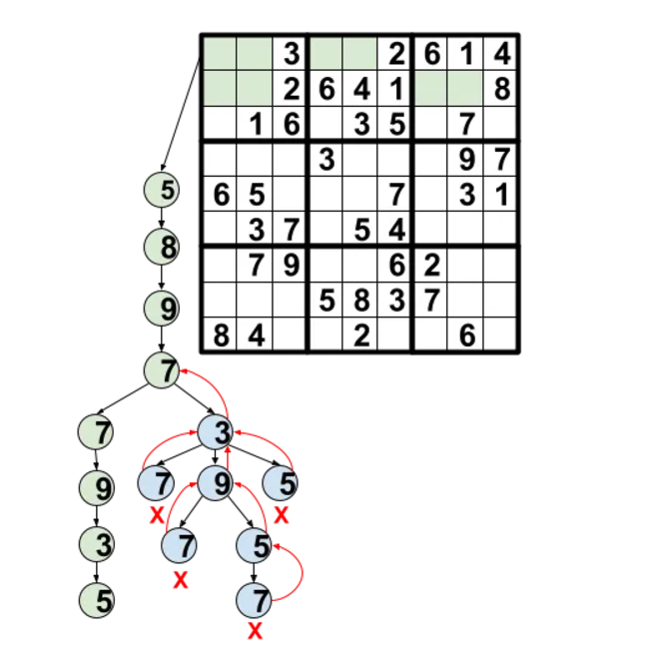
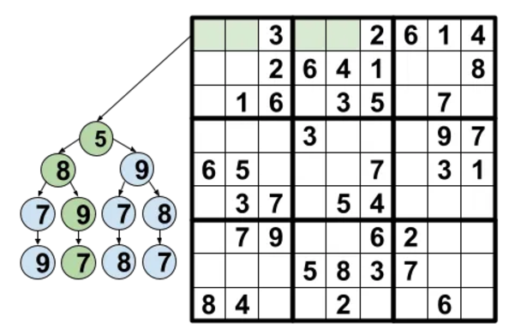
4
Backtracking

Slide 7
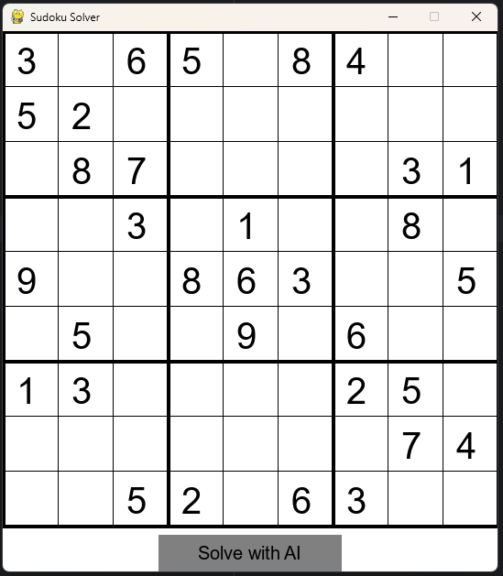
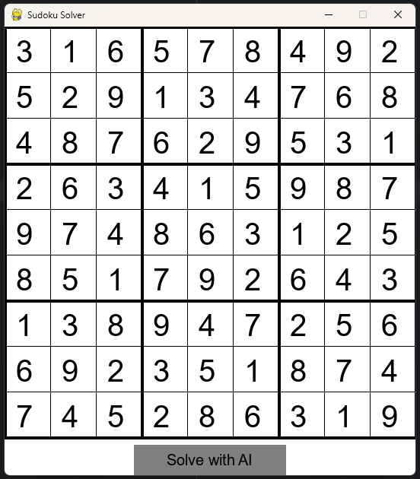
5
OUTPUT IN PYGAME

Slide 8
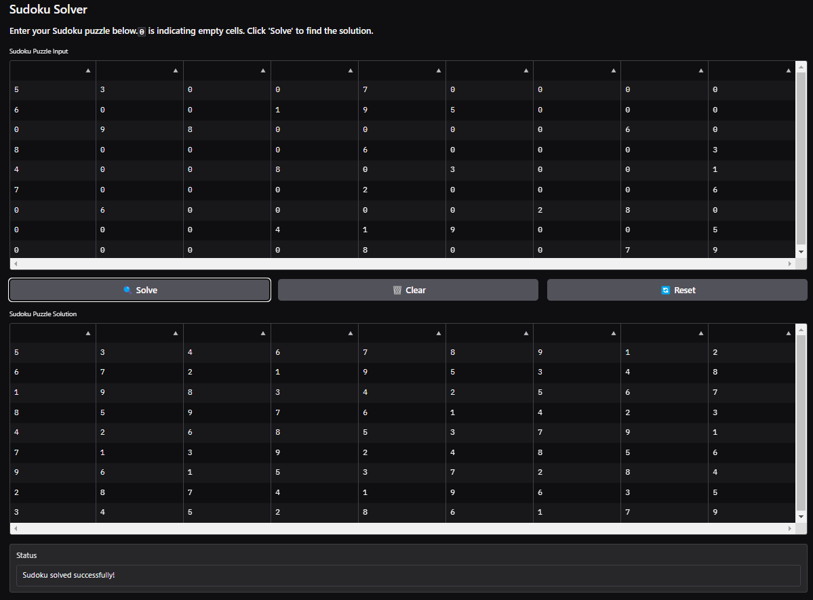
OUTPUT IN GRADIO
6
https://huggingface.co/spaces/tono-rashedul/Sudoku-Solver

Slide 9
13
CONCLUSION
Sudoku solving combines constraint propagation to simplify domains and backtracking for exhaustive search, ensuring a valid solution by exploring possibilities and backtracking when conflicts arise. Efficient for both easy and complex puzzles.

Slide 10
7
REFERENCES
https://www.geeksforgeeks.org/constraint-satisfaction-problems-csp-in-artificial-intelligence/
https://medium.com/@co.2020.prkude/formulation-of-csp-problem-sudoku-puzzle-7d5e1d547382
https://en.wikipedia.org/wiki/Sudoku
https://en.wikipedia.org/wiki/Backtracking
https://towardsdatascience.com/sudoku-solver-48cb2744fbd4

Slide 11
THANK YOU

